Slide 1
Child Abuse in America
Name
Institution
Date

Slide 2
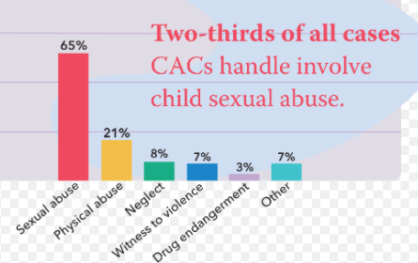
Introduction
  Child abuse refers to any physical violence or mistreatment on a child
  It can be violent or threatening to a child
  Child abuse has different causes and effects (Abrams, Milisavljević, & Šoškić, 2019)
Notes:
Child abuse refers to when a child is harmed intentionally by an adult or any other child. It can occur in a long period or a one-off action. Child abuse can occur sexually, emotionally, physically, or even online (Abrams et al., 2019). Child abuse can also happen in terms of neglect; that is, when the caregiver does not offer care, attention, or love. Child abuse bears different effects and these include abandonment, limited development in social settings, and long lasting effects that could continue all the way through adulthood.

Slide 3
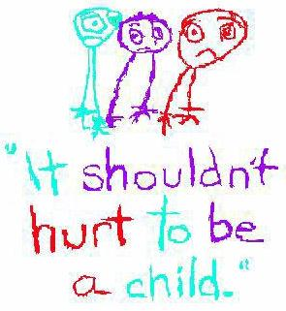
Causes of Child Abuse
    Child abuse in America may be caused by a couple of factors and these include:
      Isolation and support may lack
      Drug problems and gambling
      Expectations that may not be realistic
      Disability and mental illness
      Skills of parenting may lack
      Lack of one's self-confidence (Abrams et al., 2019)
      Alcohol and drug abuse
Notes:
Various reasons may cause child abuse. The caregiver may lack members of the family or friends to help with the demands arising during parenting. The parent or caregiver may have substance abuse or addictions, which may hinder the caregiver's ability to satisfy the child's needs. A parent may also lack knowledge about how children behave and how they grow and develop leading to child abuse (Abrams et al., 2019). In case the child is disabled, the parent may not be able to provide love and care for the child. Some parents may not know how to care for a child and may believe that using excessive force to punish the child may make the child disciplined. Parents may also have doubts about their capability to meet the child's needs and may shy from seeking aid. Maltreated children are most likely to be engaged in alcohol and drug abuse.

Slide 4
Child Abandonment
  Child abandonment occurs as a result of:
  Alienation from environment
  Guilt from the child
  Fear and uncertainty (Cronley et al., 2015)
  Sleep and eating disorders
  Physical ailments
Notes:
Child abuse makes a child withdraw from socializing with other people, and they seem to resist others. The child may also live to feel that they had something to do with the desertion (Cronley et al., 2015). The child may grow with insecurities and may seem to be clingy towards those they love. Issues of lack of appetite, starvation, scary dreams, and disturbed sleep may arise in the child. The child may become sickly and unhealthy.

Slide 5
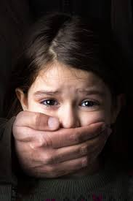
Limit of child development in school
Low cognitive functioning and academic achievement
Low level of school preparedness
Poor behavior in school
Notes:
Child abuse affects the development of a child in school. Children affected tend to have off-task behavior in school. They also tend to lack discipline. Thus they are suspended and expelled from school leading to deterioration in their performance

Slide 6
Long term effects of child abuse
Future practice of maltreatment.
Posttraumatic stress
  Poor emotional health (Cronley et al., 2015)
Notes:
Children who have been abused tend to do the same in their children's future since they did not have the luxury of parental love and care, according to Herrenkohl & Jung (2016). Abused children often have PTSD (posttraumatic stress disorder), whereby they re-experience the events related to their mistreatment. They often feel horror, fear, shame, anger, or irritability. Maltreated children are usually at risk of being depressed with psychiatric disorders such as anxiety. Abuse kids are also likely to commit suicide.

Slide 7
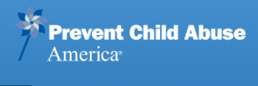
How to stop child abuse
Understand children
Parents should watch their words
Control oneself before disciplining a child
Take a time out
Avoid drugs or seek help
Notes:
Parents or caregivers should observe and learn how different children behave at different life stages. Parents should have expectations from children, and they ought to reason with kids if they fall short. Parents should set rules that the child should follow to prevent crossroads, and they should reduce severe punishment. In case one feels frustrated or disappointed because of the child's behavior, he/ she should stop or call a child abuse hotline. Parents should keep their children away from substances or anyone who abuses drugs.

Slide 8
Organizations that fight child abuse in America
  Different organizations are concerned with the welfare of children in the US and these include:
  American Psychological Association (APA)
  Centre for Effective Discipline (CED)
  Child Abuse Prevention Network
  Child Lures Prevention
  Children Without a Voice USA
Notes:
The mission of the American Psychological Association is to disseminate the application of psychological knowledge and improve the lives of people. The purpose of the Centre for Effective Discipline is to educate the public on the effects of severe punishment and alternative methods. Child Abuse Prevention Network uses internet linkages to enable professionals in the investigation and treatment of child abuse. Child Lures Prevention and Children Without a Voice helps to raise awareness concerning sexual exploitation among children

Slide 9
References
Abrams, M., Milisavljević, M., & Šoškić, A. (2019). Childhood abuse: Differential gender effects on mental health and sexuality. Sexologies: European Journal of Sexology and Sexual Health / Revue Européenne de Sexologie et de Santé Sexuelle, 28(4), e89–e96. https://doi-org.lp.hscl.ufl.edu/10.1016/j.sexol.2019.07.002
Cronley, C., Jeong, S., Davis, J. B., & Madden, E. (2015). Effects of Homelessness and Child Maltreatment on the Likelihood of Engaging in Property and Violent Crime During Adulthood. Journal of Human Behavior in the Social Environment, 25(3), 192–203. https://doi-org.lp.hscl.ufl.edu/10.1080/10911359.2014.966219
Freer, B., Sprang, G., Katz, D., Belle, C., & Sprang, K. (2017). The Impact of Child Abuse Potential on Adaptive Functioning: Early Identification of Risk. Journal of Family Violence, 32(2), 189–196. https://doi-org.lp.hscl.ufl.edu/10.1007/s10896-016-9863-6
Herrenkohl, T. I., & Jung, H. (2016). Effects of child abuse, adolescent violence, peer approval and pro-violence attitudes on intimate partner violence in adulthood. Criminal Behaviour and Mental Health, 26(4), 304–314

